Slide 1


Quantum Cryptography: Securing Communication in the Quantum Era
Quantum cryptography utilizes the principles of quantum mechanics to enable secure communication in the digital age. By harnessing the unique properties of quantum particles, this cutting-edge technology safeguards sensitive information from even the most sophisticated cyber threats.
by Dwaraka Siva Sai Sri N

Slide 2

Quantum Bits (Qubits): The Building Blocks of Quantum Cryptography
1
Superposition
2
Entanglement
Unlike classical bits, qubits can exist in multiple states simultaneously, enabling exponentially more information to be encoded.
Qubits can become "entangled", allowing their properties to be linked, even over large distances.
3
Measurement
Observing a qubit causes it to collapse into a definite state, disrupting the delicate quantum system.

Slide 3
Superposition and Uncertainty: The Foundations of Quantum Mechanics
Superposition
Uncertainty Principle
Quantum Indeterminacy
Quantum particles can exist in multiple states simultaneously, challenging our classical understanding of reality.
The more precisely the position of a particle is determined, the less precisely its momentum can be known, and vice versa.
The outcome of a quantum measurement is inherently unpredictable, introducing fundamental randomness into the universe.

Slide 4
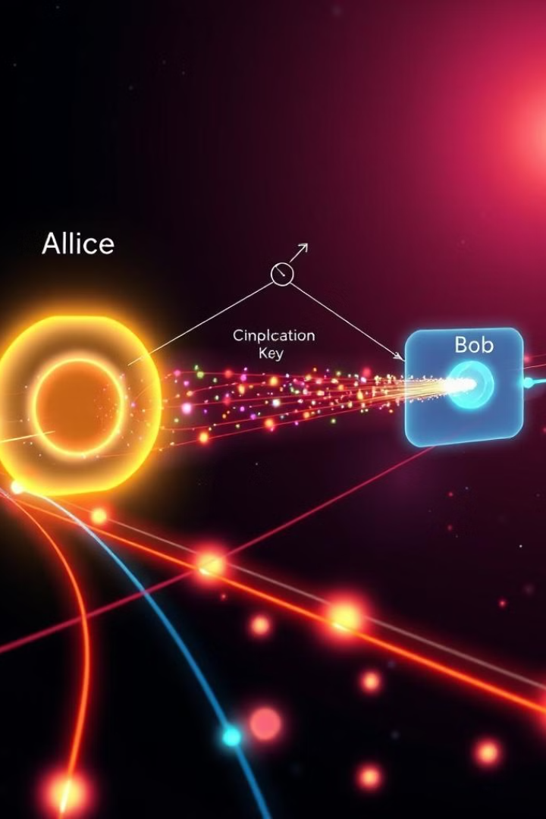
Quantum Key Distribution (QKD): Generating Shared, Secret Keys
1
Photon Transmission
Qubits are encoded into the polarization states of photons and transmitted between two parties.
2
Measurement and Detection
The receiver measures the photon states, and any eavesdropping is detected due to the disruption of the quantum system.
3
Key Reconciliation
The two parties publicly discuss a subset of the measurement results to establish a shared, secret cryptographic key.

Slide 5

No-Cloning Theorem: Preventing Eavesdropping in Quantum Networks
Unique States
Measurement Disruption
Quantum states cannot be perfectly copied or cloned, preventing eavesdroppers from intercepting and duplicating the quantum signals.
Any attempt to measure or copy the quantum states will inevitably disturb the system, alerting the communicating parties to the presence of an eavesdropper.
Unbreakable Encryption
The no-cloning theorem ensures that quantum cryptography offers a level of security that is theoretically unbreakable, even by the most advanced classical computers.

Slide 6




Entanglement: Quantum Phenomena Enabling Secure Communication
Instantaneous Correlation
Entangled qubits exhibit instantaneous correlation, even when separated by large distances, enabling the transmission of information without a physical medium.
Eavesdropping Detection
Any attempt to measure or interact with the entangled qubits disrupts the delicate quantum state, alerting the communicating parties to the presence of an eavesdropper.
Cryptographic Key Generation
Entanglement can be used to generate a shared, secret cryptographic key that is immune to eavesdropping, forming the basis of quantum key distribution.

Slide 7
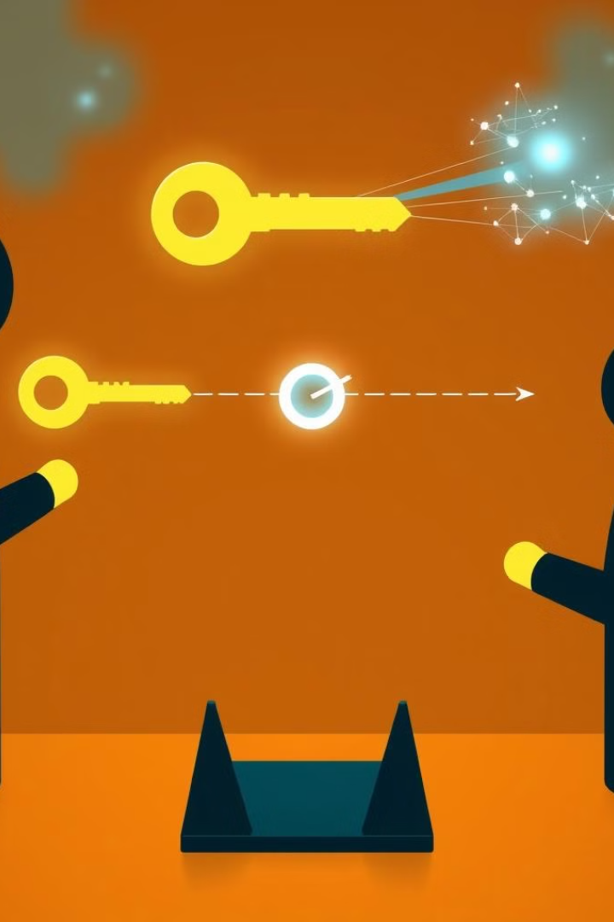



Quantum Key Exchange: The Process of Establishing a Shared Key
Photon Transmission
Qubits are encoded into the polarization states of photons and transmitted between the two communicating parties.
Measurement and Detection
The receiver measures the photon states, and any eavesdropping is detected due to the disruption of the quantum system.
Key Reconciliation
The two parties publicly discuss a subset of the measurement results to establish a shared, secret cryptographic key.

Slide 8
Quantum Cryptography Applications: From Banking to Government
Financial Security
Critical Infrastructure
Sensitive Communications
Quantum cryptography is being adopted by banks and financial institutions to safeguard sensitive transactions and data.
Governments and agencies are increasingly relying on quantum cryptography to protect essential infrastructure, such as power grids and communication networks.
Quantum cryptography is used to secure high-level government and military communications, ensuring the confidentiality of critical information.

Slide 9

Challenges and Limitations of Quantum Cryptography
1
Distance Limitations
2
Implementation Complexity
The range of quantum cryptography is currently limited due to signal loss and decoherence over long distances.
Deploying quantum cryptography requires specialized equipment and infrastructure, making it challenging to scale and integrate with existing systems.
3
Technological Maturity
4
Cost Considerations
Quantum cryptography is still a relatively new and evolving field, with ongoing research to improve its practicality and reliability.
The implementation of quantum cryptography can be costly, hindering widespread adoption, especially for smaller organizations.

Slide 10

The Future of Quantum Cryptography: Towards Unbreakable Security
1
Technological Advancements
Ongoing research and development are expected to increase the range, efficiency, and reliability of quantum cryptography systems.
2
Widespread Adoption
As the technology matures, quantum cryptography is poised to become a standard for securing critical communications and data in a wide range of industries.
3
Unbreakable Encryption
The fundamental principles of quantum mechanics will enable quantum cryptography to provide a level of security that is theoretically unbreakable, even by the most powerful future computers.

